Slide 1
Chapter 9 Objects and Classes

Slide 2

Motivations
After learning the preceding chapters, you are capable of solving many programming problems using selections, loops, methods, and arrays.
However, these Java features are not sufficient for developing graphical user interfaces and large-scale software systems.
Suppose you want to develop a graphical user interface as shown below. How do you program it?

Slide 3
Objectives
To describe objects and classes, and use classes to model objects (§9.2).
To use UML graphical notation to describe classes and objects (§9.2).
To demonstrate how to define classes and create objects (§9.3).
To create objects using constructors (§9.4).
To access objects via object reference variables (§9.5).
To define a reference variable using a reference type (§9.5.1).
To access an object’s data and methods using the object member access operator (.) (§9.5.2).
To define data fields of reference types and assign default values for an object’s data fields (§9.5.3).
To distinguish between object reference variables and primitive data type variables (§9.5.4).
To use the Java library classes Date, Random, and Point2D (§9.6).
To distinguish between instance and static variables and methods (§9.7).
To define private data fields with appropriate get and set methods (§9.8).
To encapsulate data fields to make classes easy to maintain (§9.9).
To develop methods with object arguments and differentiate between primitive-type arguments and object-type arguments (§9.10).
To store and process objects in arrays (§9.11).
To create immutable objects from immutable classes to protect the contents of objects (§9.12).
To determine the scope of variables in the context of a class (§9.13).
To use the keyword this to refer to the calling object itself (§9.14).

Slide 4
OO Programming Concepts
Object-oriented programming (OOP) involves programming using objects.
An object represents an entity in the real world that can be distinctly identified.
For example, a student, a desk, a circle, a button, and even a loan can all be viewed as objects.
An object has a unique identity, state, and behaviors.
The state of an object consists of a set of data fields (also known as properties) with their current values.
The behavior of an object is defined by a set of methods.

Slide 5
Objects
An object has both a state and behavior.
The state defines the object, and the behavior defines what the object does.

Slide 6
Classes
Classes are constructs that define objects of the same type.
A Java class uses variables to define data fields and methods to define behaviors.
Additionally, a class provides a special type of methods, known as constructors, which are invoked to construct objects from the class.

Slide 7
Classes

Slide 8
UML Class Diagram

Slide 9
Example: Defining Classes and Creating Objects
Objective: Demonstrate creating objects, accessing data, and using methods.
TestSimpleCircle
Run

Slide 10
Example: Defining Classes and Creating Objects
TV
TestTV
Run

Slide 11
☑ Check Point
How do you define a class?
How do you declare an object's reference variable?
How do you create an object?
<--- ANSWER --->
The syntax to define a class is public class ClassName { }
The syntax to declare a reference variable for an object is ClassName v;
The syntax to create an object is new ClassName();

Slide 12
Constructors
Constructors are a special kind of methods that are invoked to construct objects.
Circle() {
}
Circle(double newRadius) {
radius = newRadius;
}

Slide 13
Constructors, cont.
A constructor with no parameters is referred to as a no-arg constructor.
Constructors must have the same name as the class itself.
Constructors do not have a return type—not even void.
Constructors are invoked using the new operator when an object is created. Constructors play the role of initializing objects.

Slide 14
Creating Objects Using Constructors
new ClassName();
Example:
new Circle();
new Circle(5.0);

Slide 15
Default Constructor
A class may be defined without constructors.
In this case, a no-arg constructor with an empty body is implicitly defined in the class.
This constructor, called a default constructor, is provided automatically only if no constructors are explicitly defined in the class.

Slide 16
☑ Check Point
What are the differences between constructors and methods?
When will a class have a default constructor?
<--- ANSWER --->
Constructors are special kinds of methods that are called when creating an object using the new operator. Constructors do not have a return type, not even void.
A class has a default constructor only if the class does not define any constructor.

Slide 17
Declaring Object Reference Variables
To reference an object, assign the object to a reference variable.
To declare a reference variable, use the syntax:
ClassName objectRefVar;
Example:
Circle myCircle;

Slide 18
Declaring/Creating Objects in a Single Step
ClassName objectRefVar = new ClassName();
Example:
Circle myCircle = new Circle();
Assign object reference
Create an object

Slide 19
Accessing Object’s Members
Referencing the object’s data:
objectRefVar.data
e.g., myCircle.radius
Invoking the object’s method:
objectRefVar.methodName(arguments)
e.g., myCircle.getArea()

Slide 20
Trace Code
animation
Declare myCircle
Circle myCircle = new Circle(5.0);
Circle yourCircle = new Circle();
yourCircle.radius = 100;
myCircle
no value

Slide 21
Trace Code, cont.
animation
Circle myCircle = new Circle(5.0);
Circle yourCircle = new Circle();
yourCircle.radius = 100;
myCircle
no value
Create a circle

Slide 22
Trace Code, cont.
animation
Circle myCircle = new Circle(5.0);
Circle yourCircle = new Circle();
yourCircle.radius = 100;
myCircle
reference value
Assign object reference to myCircle

Slide 23
Trace Code, cont.
animation
Circle myCircle = new Circle(5.0);
Circle yourCircle = new Circle();
yourCircle.radius = 100;
myCircle
reference value
yourCircle
no value
Declare yourCircle

Slide 24
Trace Code, cont.
animation
Circle myCircle = new Circle(5.0);
Circle yourCircle = new Circle();
yourCircle.radius = 100;
myCircle
reference value
yourCircle
no value
Create a new Circle object

Slide 25
Trace Code, cont.
animation
Circle myCircle = new Circle(5.0);
Circle yourCircle = new Circle();
yourCircle.radius = 100;
myCircle
reference value
yourCircle
reference value
Assign object reference to yourCircle

Slide 26
Trace Code, cont.
animation
Circle myCircle = new Circle(5.0);
Circle yourCircle = new Circle();
yourCircle.radius = 100;
myCircle
reference value
yourCircle
reference value
Change radius in yourCircle

Slide 27
Caution
Recall that you use
Math.methodName(arguments) (e.g., Math.pow(3, 2.5))
to invoke a method in the Math class.
Can you invoke getArea() using SimpleCircle.getArea()?
The answer is no. All the methods used before this chapter are static methods, which are defined using the static keyword.
However, getArea() is non-static. It must be invoked from an object using
objectRefVar.methodName(arguments) (e.g., myCircle.getArea()).
More explanations will be given in the section on “Static Variables, Constants, and Methods.”

Slide 28
Reference Data Fields
The data fields can be of reference types.
For example, the following Student class contains a data field name of the String type.
public class Student {
String name; // name has default value null
int age; // age has default value 0
boolean isScienceMajor; // isScienceMajor has default value false
char gender; // c has default value '\u0000'
}

Slide 29
The null Value
If a data field of a reference type does not reference any object, the data field holds a special literal value, null.

Slide 30
Default Value for a Data Field
The default value of a data field is
>> null for a reference type,
>> 0 for a numeric type,
>> false for a boolean type, and
>> '\u0000' for a char type.
However, Java assigns no default value to a local variable inside a method.
public class Test {
public static void main(String[] args) {
Student student = new Student();
System.out.println("name? " + student.name);
System.out.println("age? " + student.age);
System.out.println("isScienceMajor? " + student.isScienceMajor);
System.out.println("gender? " + student.gender);
}
}

Slide 31
Example
Java assigns no default value to a local variable inside a method.
public class Test {
public static void main(String[] args) {
int x; // x has no default value
String y; // y has no default value
System.out.println("x is " + x);
System.out.println("y is " + y);
}
}
Compile error: variable not initialized

Slide 32
Differences between Variables of Primitive Data Types and Object Types

Slide 33
Copying Variables of Primitive Data Types and Object Types

Slide 34
Garbage Collection
As shown in the previous figure,
after the assignment statement c1 = c2,
c1 points to the same object referenced by c2.
The object previously referenced by c1 is no longer referenced.
This object is known as garbage. Garbage is automatically collected by JVM.

Slide 35
Garbage Collection, cont
TIP: If you know that an object is no longer needed, you can explicitly assign null to a reference variable for the object.
The JVM will automatically collect the space if the object is not referenced by any variable.

Slide 36
☑ Check Point
Which operator is used to access a data field or invoke a method from an object?
What is an anonymous object?
What is NullPointerException?
Is an array an object or a primitive type value?
Can an array contain elements of an object type?
Describe the default value for the elements of an array.
<--- ANSWER --->
The member access operator is used to access a data field or invoke a method from an object.
An anonymous object is the one that does not have a reference variable referencing it.
A NullPointerException occurs when a null reference variable is used to access the members of an object.
An array is an object.
An array can contain elements of an object type.
The default value for the elements of an array is 0 for numeric, false for boolean, '\u0000' for char, null for object element type.

Slide 37
☑ Check Point
What is wrong with the following program? 1 public class ShowErrors { 2 public static void main(String[] args) { 3 ShowErrors t = new ShowErrors(5); 4 } 5 }
<--- ANSWER --->
There is no such constructor ShowErrors(int) in the ShowErrors class.The ShowErrors class has a default constructor. It is actually same as public class ShowErrors { public static void main(String[] args) { ShowErrors t = new ShowErrors(5); } public ShowErrors () { } } On Line 3, new ShowErrors(5) attempts to create an instance using a constructor ShowErrors(int), but the ShowErrors class does not have such a constructor. That is an error.

Slide 38
☑ Check Point
What is wrong with the following program? 1 public class ShowErrors { 2 public static void main(String[] args) { 3 ShowErrors t = new ShowErrors(); 4 t.x(); 5 } 6 }
<--- ANSWER --->
x() is not a method in the ShowErrors class.The ShowErrors class has a default constructor. It is actually same as public class ShowErrors { public static void main(String[] args) { ShowErrors t = new ShowErrors(); t.x(); } public ShowErrors () { } } On Line 4, t.x() is invoked, but the ShowErrors class does not have the method named x(). That is an error.

Slide 39
☑ Check Point
What is wrong with the following program? 1 public class ShowErrors { 2 public void method1() { 3 Circle c; 4 System.out.println("What is radius " 5 + c.getRadius()); 6 c = new Circle(); 7 } 8 }
<--- ANSWER --->
The program compiles fine, but it has a runtime error because variable c is null when the println statement is executed.

Slide 40
☑ Check Point
What is wrong with the following program? 1 public class ShowErrors { 2 public static void main(String[] args) { 3 C c = new C(5.0); 4 System.out.println(c.value); 5 } 6 } 7 8 class C { 9 int value = 2; 10 }
<--- ANSWER --->
new C(5.0) does not match any constructors in class C. The program has a compilation error because class C does not have a constructor with a double argument.

Slide 41
☑ Check Point
What is wrong in the following code? 1 class Test { 2 public static void main(String[] args) { 3 A a = new A(); 4 a.print(); 5 } 6 } 7 8 class A { 9 String s; 10 11 A(String newS) { 12 s = newS; 13 } 14 15 public void print() { 16 System.out.print(s); 17 } 18 }
<--- ANSWER --->
The program does not compile because new A() is used in class Test, but class A does not have a default constructor. A default constructor is provided automatically only if no constructors are explicitly defined in the class.

Slide 42
☑ Check Point
What is the output of the following code? public class A { boolean x; public static void main(String[] args) { A a = new A(); System.out.println(a.x); } }
<--- ANSWER --->
false

Slide 43
The Date Class
Java provides a system-independent encapsulation of date and time in the java.util.Date class.
You can use the Date class to create an instance for the current date and time and use its toString method to return the date and time as a string.

Slide 44
The Date Class Example
For example, the following code
java.util.Date date = new java.util.Date();
System.out.println(date.toString());
displays a string like
Sun Mar 09 13:50:19 EST 2003.

Slide 45
The Random Class
You have used Math.random() to obtain a random double value between 0.0 and 1.0 (excluding 1.0).
A more useful random number generator is provided in the java.util.Random class.

Slide 46
The Random Class Example
If two Random objects have the same seed, they will generate identical sequences of numbers.
For example, the following code creates two Random objects with the same seed 3.
Random random1 = new Random(3);
System.out.print("From random1: ");
for (int i = 0; i < 10; i++)
System.out.print(random1.nextInt(1000) + " ");
Random random2 = new Random(3);
System.out.print("\nFrom random2: ");
for (int i = 0; i < 10; i++)
System.out.print(random2.nextInt(1000) + " ");
From random1: 734 660 210 581 128 202 549 564 459 961
From random2: 734 660 210 581 128 202 549 564 459 961

Slide 47
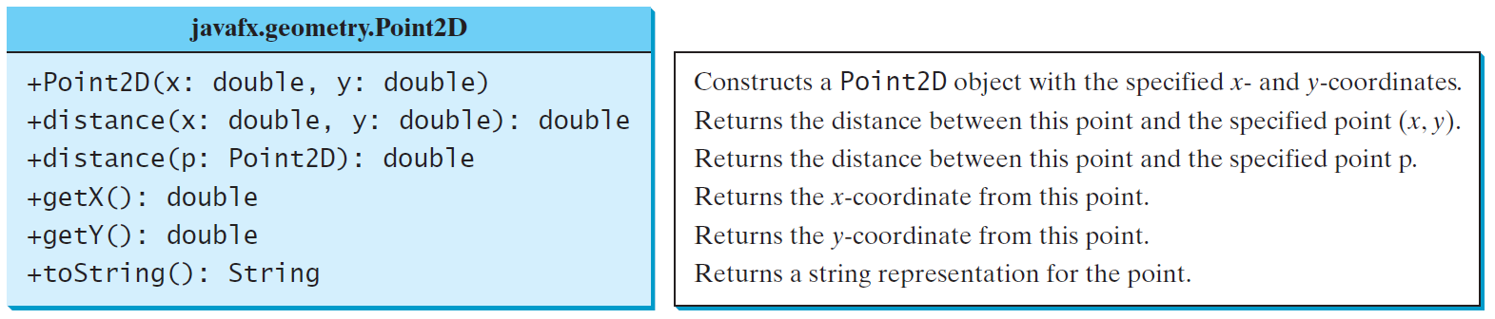
The Point2D Class
Java API has a conveninent Point2D class in the javafx.geometry package for representing a point in a two-dimensional plane.
TestPoint2D
Run

Slide 48
☑ Check Point
How do you create a Date for the current time? How do you display the current time?
How do you create a Point2D? Suppose p1 and p2 are two instances of Point2D, how do you obtain the distance between the two points? How do you obtain the midpoint between the two points?
Which packages contain the classes Date, Random, Point2D, System, and Math?
<--- ANSWER --->
Use the Date's no-arg constructor to create a Date for the current time. Use the Date's toString() method to display a string representation for the Date.
You can create a Point2D object using its constructor Point2D(x, y) for a point at (x, y). Use p1.distance(p2) to obtain the distance between p1 and p2. Use p1.midPoint(p2) to obtain the mid-point between p1 and p2.
Date is in the java.util package. Random is in the java.util package. Point2D is in the javafx.geometry package. System and Math are in the java.lang package.

Slide 49
Instance Variables, and Methods
Instance variables belong to a specific instance. Instance methods are invoked by an instance of the class.

Slide 50
Static Variables, Constants, and Methods
Static variables are shared by all the instances of the class. Static methods are not tied to a specific object.
Static constants are final variables shared by all the instances of the class.

Slide 51
Static Variables, Constants, and Methods, cont.
To declare static variables, constants, and methods, use the static modifier.

Slide 52
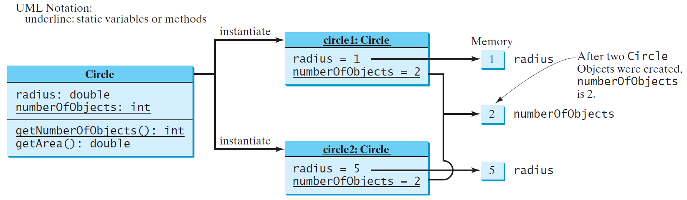
Static Variables, Constants, and Methods, cont.

Slide 53
Example of Using Instance and Class Variables and Method
Objective: Demonstrate the roles of instance and class variables and their uses. This example adds a class variable numberOfObjects to track the number of Circle objects created.
CircleWithStaticMembers
TestCircleWithStaticMembers
Run

Slide 54
☑ Check Point
Suppose that the class F is defined in (a). Let f be an instance of F. Which of the statements in (b) are correct?
(b) System.out.println(f.i);
System.out.println(f.s);
f.imethod();
f.smethod();
System.out.println(F.i);
System.out.println(F.s);
F.imethod();
F.smethod();
<--- ANSWER --->
Correct
Correct
Correct
Correct
Incorrect
Correct
Incorrect
Correct
(a) public class F { int i; static String s; void imethod() { } static void smethod() { } }

Slide 55
☑ Check Point
Add the static keyword in the place of ___ if appropriate. public class Test { int count; public ___ void main(String[] args) { ... } public ___ int getCount() { return count; } public ___ int factorial(int n) { int result = 1; for (int i = 1; i <= n; i++) result *= i; return result; } }
<--- ANSWER --->
Add static in the main method and in the factorial method because these two methods do not need reference any instance objects or invoke any instance methods in the Test class.

Slide 56
☑ Check Point
Can you invoke an instance method or reference an instance variable from a static method?
Can you invoke a static method or reference a static variable from an instance method?
<--- ANSWER --->
You cannot invoke an instance method or reference an instance variable from a static method.
You can invoke a static method or reference a static variable from an instance method.

Slide 57
☑ Check Point
What is wrong in the following code? 1 public class C { 2 Circle c = new Circle(); 3 4 public static void main(String[] args) { 5 method1(); 6 } 7 8 public void method1() { 9 method2(); 10 } 11 12 public static void method2() { 13 System.out.println("What is radius " + c.getRadius()); 14 } 15 }
<--- ANSWER --->
(a) The main method is static and cannot invoke the instance method method1. (b) c is an instance variable, which cannot be accessed from the static context in method2.

Slide 58
Visibility Modifiers and Accessor/Mutator Methods
By default, the class, variable, or method can be accessed by any class in the same package.
public
The class, data, or method is visible to any class in any package.
private
The data or methods can be accessed only by the declaring class.
The get and set methods are used to read and modify private properties.

Slide 59
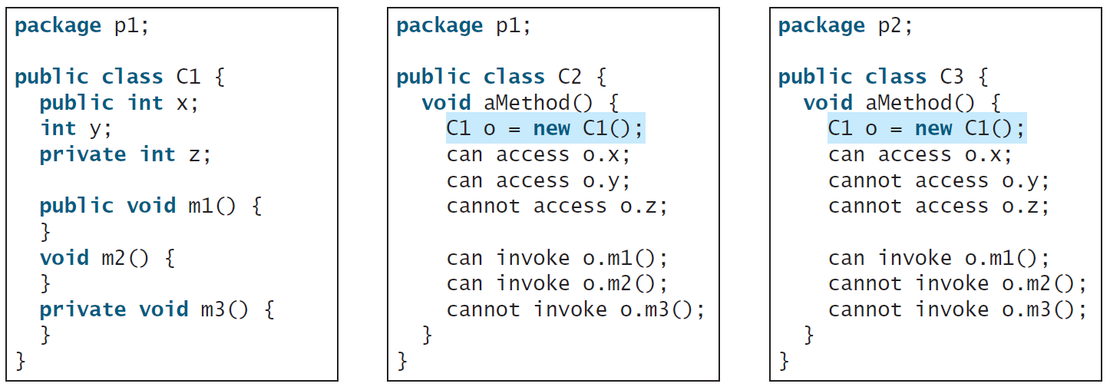
The private modifier restricts access to within a class,
the default modifier restricts access to within a package, and
the public modifier enables unrestricted access.

Slide 60
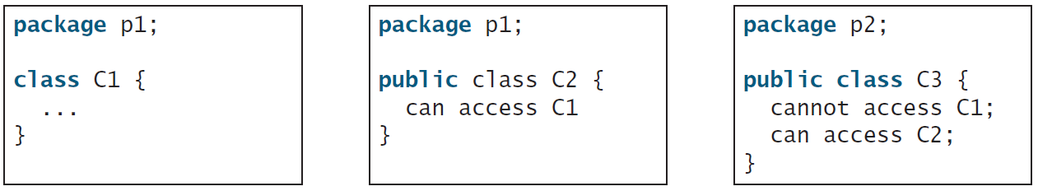
The default modifier on a class restricts access to within a package, and
the public modifier enables unrestricted access.

Slide 61
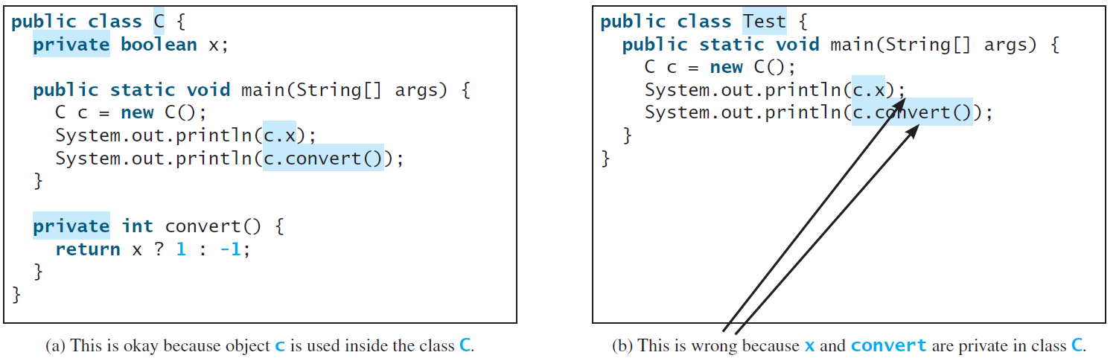
NOTE
An object cannot access its private members, as shown in (b).
It is OK, however, if the object is declared in its own class, as shown in (a).

Slide 62
Why Data Fields Should Be private?
To protect data.
To make code easy to maintain.

Slide 63
Example of Data Field Encapsulation
CircleWithPrivateDataFields
TestCircleWithPrivateDataFields
Run

Slide 64
☑ Check Point
What is an accessor method? What is a mutator method?
What are the naming conventions for accessor methods and mutator methods?
What are the benefits of data field encapsulation?
<--- ANSWER --->
Accessor method is for retrieving private data value and mutator method is for changing private data value.
The naming convention for accessor method is getDataFieldName() for non-boolean values and isDataFieldName() for boolean values. The naming convention for mutator method is setDataFieldName(value).
Two benefits: (1) for protecting data, and (2) for easy to maintain the class.

Slide 65
☑ Check Point
In the following code, radius is private in the Circle class, and myCircle is an object of the Circle class. Does the highlighted code cause any problems? If so, explain why. public class Circle { private double radius = 1; /** Find the area of this circle */ public double getArea() { return radius * radius * Math.PI; } public static void main(String[] args) { Circle myCircle = new Circle(); System.out.println("Radius is " + myCircle.radius); } }
<--- ANSWER --->
Not a problem. Though radius is private, myCircle.radius is used inside the Circle class. Thus, it is fine.

Slide 66
Passing Objects to Methods
Passing by value for primitive type value (the value is passed to the parameter)
Passing by value for reference type value (the value is the reference to the object)
TestPassObject
Run

Slide 67
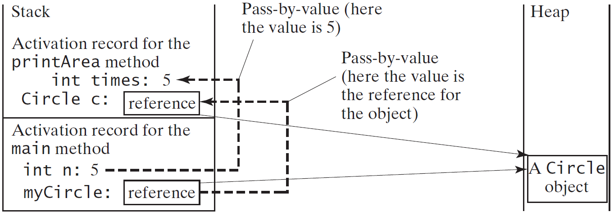
Passing Objects to Methods, cont.

Slide 68
☑ Check Point
Describe the difference between passing a parameter of a primitive type and passing a parameter of a reference type. Show the output of the following program: public class Test { public static void main(String[] args) { Count myCount = new Count(); int times = 0; for (int i = 0; i < 100; i++) increment(myCount, times); System.out.println("count is " + myCount.count); System.out.println("times is " + times); } public static void increment(Count c, int times) { c.count++; times++; } } class Count { public int count; public Count(int c) { count = c; } public Count() { count = 1; } }
<--- ANSWER --->
Java uses "pass by value" to pass parameters to a method. When passing a variable of a primitive type to a method, the variable remains unchanged after the method finishes. However, when passing a variable of a reference type to a method, any changes to the object referenced by the variable inside the method are permanent changes to the object referenced by the variable outside of the method. Both the actual parameter and the formal parameter variables reference to the same object. The output of the program is as follows: count 101 times 0

Slide 69
☑ Check Point
Show the output of the following program: public class Test { public static void main(String[] args) { Circle circle1 = new Circle(1); Circle circle2 = new Circle(2); swap1(circle1, circle2); System.out.println("After swap1: circle1 = " + circle1.radius + " circle2 = " + circle2.radius); swap2(circle1, circle2); System.out.println("After swap2: circle1 = " + circle1.radius + " circle2 = " + circle2.radius); } public static void swap1(Circle x, Circle y) { Circle temp = x; x = y; y = temp; } public static void swap2(Circle x, Circle y) { double temp = x.radius; x.radius = y.radius; y.radius = temp; } } class Circle { double radius; Circle(double newRadius) { radius = newRadius; } }
<--- ANSWER --->
After swap1: circle1 = 1.0 circle2 = 2.0 After swap2: circle1 = 2.0 circle2 = 1.0 The reference value of circle1 is passed to x and the reference value of circle2 is passed to y. The contents of the objects are not swapped in the swap1 method. circle1 and circle2 are not swapped. To actually swap the contents of these objects, replace the following three lines Circle temp = x; x = y; y = temp; by double temp = x.radius; x.radius = y.radius; y.radius = temp; as in swap2.

Slide 70
☑ Check Point
Show the output of the following code: (a) public class Test { public static void main(String[] args) { int[] a = {1, 2}; swap(a[0], a[1]); System.out.println("a[0] = " + a[0] + " a[1] = " + a[1]); } public static void swap(int n1, int n2) { int temp = n1; n1 = n2; n2 = temp; } }
(b) public class Test { public static void main(String[] args) { int[] a = {1, 2}; swap(a); System.out.println("a[0] = " + a[0] + " a[1] = " + a[1]); } public static void swap(int[] a) { int temp = a[0]; a[0] = a[1]; a[1] = temp; } }
<--- ANSWER --->
(a) a[0] = 1 a[1] = 2
(b) a[0] = 2 a[1] = 1

Slide 71
☑ Check Point
Show the output of the following code: (c) public class Test { public static void main(String[] args) { T t = new T(); swap(t); System.out.println("e1 = " + t.e1 + " e2 = " + t.e2); } public static void swap(T t) { int temp = t.e1; t.e1 = t.e2; t.e2 = temp; } } class T { int e1 = 1; int e2 = 2; }
(d) public class Test { public static void main(String[] args) { T t1 = new T(); T t2 = new T(); System.out.println("t1's i = " + t1.i + " and j = " + t1.j); System.out.println("t2's i = " + t2.i + " and j = " + t2.j); } } class T { static int i = 0; int j = 0; T() { i++; j = 1; } }
<--- ANSWER --->
(c) e1 = 2 e2 = 1
(d) t1's i = 2 and j = 1 t2's i = 2 and j = 1

Slide 72
☑ Check Point
What is the output of the following programs: (a) import java.util.Date; public class Test { public static void main(String[] args) { Date date = null; m1(date); System.out.println(date); } public static void m1(Date date) { date = new Date(); } }
(b) import java.util.Date; public class Test { public static void main(String[] args) { Date date = new Date(1234567); m1(date); System.out.println(date.getTime()); } public static void m1(Date date) { date = new Date(7654321); } }
<--- ANSWER --->
(a) null
(b) 1234567
Note that Java passes the value to an argument when invoking a method. In (a) and (b), the reference of a Date object is passed to a Date parameter in method m1. The method assigns a Date object to variable date. The variable date is changed in method m1, but it does not change date in the main method.

Slide 73
☑ Check Point
What is the output of the following programs: (c) import java.util.Date; public class Test { public static void main(String[] args) { Date date = new Date(1234567); m1(date); System.out.println(date.getTime()); } public static void m1(Date date) { date.setTime(7654321); } }
(d) import java.util.Date; public class Test { public static void main(String[] args) { Date date = new Date(1234567); m1(date); System.out.println(date.getTime()); } public static void m1(Date date) { date = null; } }
<--- ANSWER --->
(c) 7654321
(d) 1234567
Note that Java passes the value to an argument when invoking a method. In (d), the reference of a Date object is passed to a Date parameter in method m1. The method assigns a Date object to variable date. The variable date is changed in method m1, but it does not change date in the main method.
In (c), the main method invokes m1 by passing the reference of the Date object. Method m1 sets a new time in the Date object. Since the reference variable date in both the main method and m1 point to the same Date object, a new time is set in method m1 using setTime(7654321), the getTime() is used to retrieve this time from the same object in the main method.

Slide 74
Array of Objects
Circle[] circleArray = new Circle[10];
An array of objects is actually an array of reference variables.
So, invoking circleArray[1].getArea() involves two levels of referencing as shown in the next figure.
circleArray references to the entire array.
circleArray[1] references to a Circle object.

Slide 75
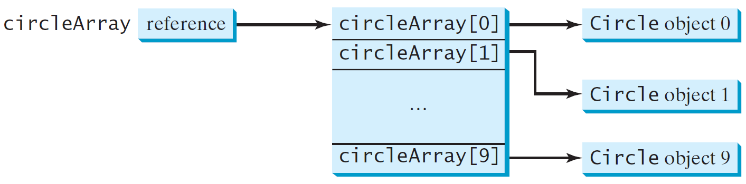
Array of Objects, cont.
Circle[] circleArray = new Circle[10];

Slide 76
Array of Objects, cont.
Summarizing the areas of the circles
TotalArea
Run

Slide 77
☑ Check Point
What is wrong in the following code? 1 public class Test { 2 public static void main(String[] args) { 3 java.util.Date[] dates = new java.util.Date[10]; 4 System.out.println(dates[0]); 5 System.out.println(dates[0].toString()); 6 } 7 }
<--- ANSWER --->
Line 4 prints null since dates[0] is null. Line 5 causes a NullPointerException since it invokes toString() method from the null reference.

Slide 78
Immutable Objects and Classes
If the contents of an object cannot be changed once the object is created, the object is called an immutable object and its class is called an immutable class.
If you delete the set method in the Circle class in Listing 8.10, the class would be immutable because radius is private and cannot be changed without a set method.
A class with all private data fields and without mutators is not necessarily immutable.
For example, the following class Student has all private data fields and no mutators, but it is mutable.

Slide 79
Example
public class BirthDate { private int year; private int month; private int day; public BirthDate(int newYear, int newMonth, int newDay) { year = newYear; month = newMonth; day = newDay; } public void setYear(int newYear) { year = newYear; } }
public class Student { private int id; private BirthDate birthDate; public Student(int ssn, int year, int month, int day) { id = ssn; birthDate = new BirthDate(year, month, day); } public int getId() { return id; } public BirthDate getBirthDate() { return birthDate; } }
public class Test { public static void main(String[] args) { Student student = new Student(111223333, 1970, 5, 3); BirthDate date = student.getBirthDate(); date.setYear(2010); // Now the student birth year is changed! } }

Slide 80
What Class is Immutable?
For a class to be immutable,
it must mark all data fields private, and
provide no mutator methods, and
no accessor methods that would return a reference to a mutable data field object.

Slide 81
☑ Check Point
If a class contains only private data fields and no setter methods, is the class immutable?
If all the data fields in a class are private and of primitive types, and the class doesn't contain any setter methods, is the class immutable?
Is the following class immutable? public class A { private int[] values; public int[] getValues() { return values; } }
<--- ANSWER --->
Not necessarily. To be immutable, the class must also contain no getter methods that would return a reference to a mutable data field object.
Yes
No, because values is a reference type.

Slide 82
Scope of Variables
The scope of instance and static variables is the entire class. They can be declared anywhere inside a class.
The scope of a local variable starts from its declaration and continues to the end of the block that contains the variable. A local variable must be initialized explicitly before it can be used.
If a local variable has the same name as a class’s variable, the local variable takes precedence and the class’s variable with the same name is hidden.

Slide 83
☑ Check Point
What is the output of the following program? public class Test { private static int i = 0; private static int j = 0; public static void main(String[] args) { int i = 2; int k = 3; { int j = 3; System.out.println("i + j is " + i + j); } k = i + j; System.out.println("k is " + k); System.out.println("j is " + j); } }
<--- ANSWER --->
i + j is 23 (because i (value of 2) is concatenated with string "i + j is", then j (value of 3) is concatenated with string "i + j is 2".) k is 2 j is 0

Slide 84
The this Keyword
The this keyword is the name of a reference that refers to an object itself.
One common use of the this keyword is reference a class’s hidden data fields.
Another common use of the this keyword to enable a constructor to invoke another constructor of the same class.

Slide 85
Reference the Hidden Data Fields

Slide 86
Calling Overloaded Constructor
Java requires that the this(arg-list) statement appear first in the constructor before any other executable statements.

Slide 87
☑ Check Point
Describe the role of the this keyword.
What is wrong in the following code? 1 public class C { 2 private int p; 3 4 public C() { 5 System.out.println("C's no-arg constructor invoked"); 6 this(0); 7 } 8 9 public C(int p) { 10 p = p; 11 } 12 13 public void setP(int p) { 14 p = p; 15 } 16 }
<--- ANSWER --->
this refers to the object itself.
Swap line 5 with line 6. Lines 10 and 14, should be this.p = p;

Slide 88
☑ Check Point
What is wrong in the following code? public class Test { private int id; public void m1() { this.id = 45; } public void m2() { Test.id = 45; } }
<--- ANSWER --->
Test.id = 45; This is wrong, since id is an instance member and cannot be accessed from a class.

